Slide 1
An Evaluation of Methods for Handling Missing Data in
Randomized Controlled Trials with
Omitted Moderation Effects
Student: Elizabeth Pauley, University of Rhode Island epauley@uri.edu
Mentor: Katia Bulekova, boston university, ktrn@bu.edu
Researcher: Manshu Yang, University of Rhode Island myang@uri.ed
April 19, 2024

Slide 2
Methods for Missing Data in
RCTs w/OMEs
Compare methods (IPW, MI-CE, MI-JM, LD & CD) via Monte Carlo Simulation using Unity
Evaluate Relative Bias and Type I Error

Slide 3
Methods for Missing Data in
RCTs w/OMEs
Goals
  Expand working knowledge of HPC
  Expand knowledge of Monte Carlo Simulation Studies
  Determine recommended method based on results

Slide 4
Methods for Missing Data in
RCTs w/OMEs
Timeframe
  October 2023
  April 2024

Slide 5
Methods for Missing Data in
RCTs w/OMEs
What we accomplished
  Improved code efficiency
  Obtained results from HPC & compiled multiple arrays for analysis
  Draft of manuscript in progress

Slide 6
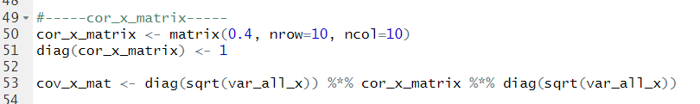
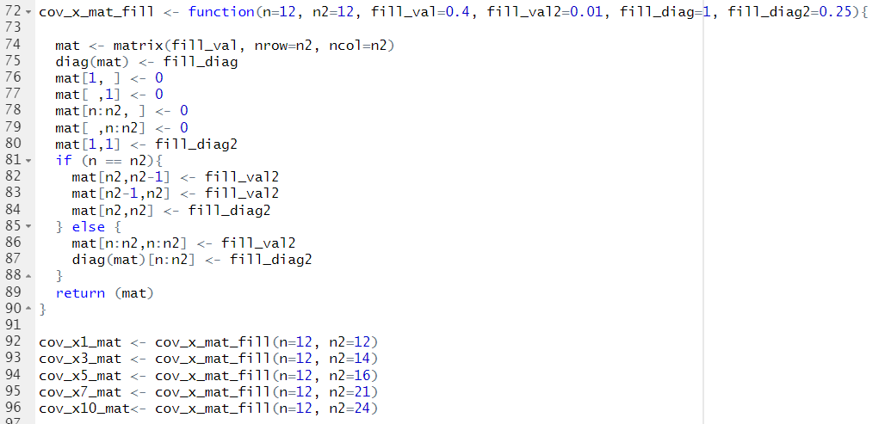
Code Efficiency Improvements

Slide 7
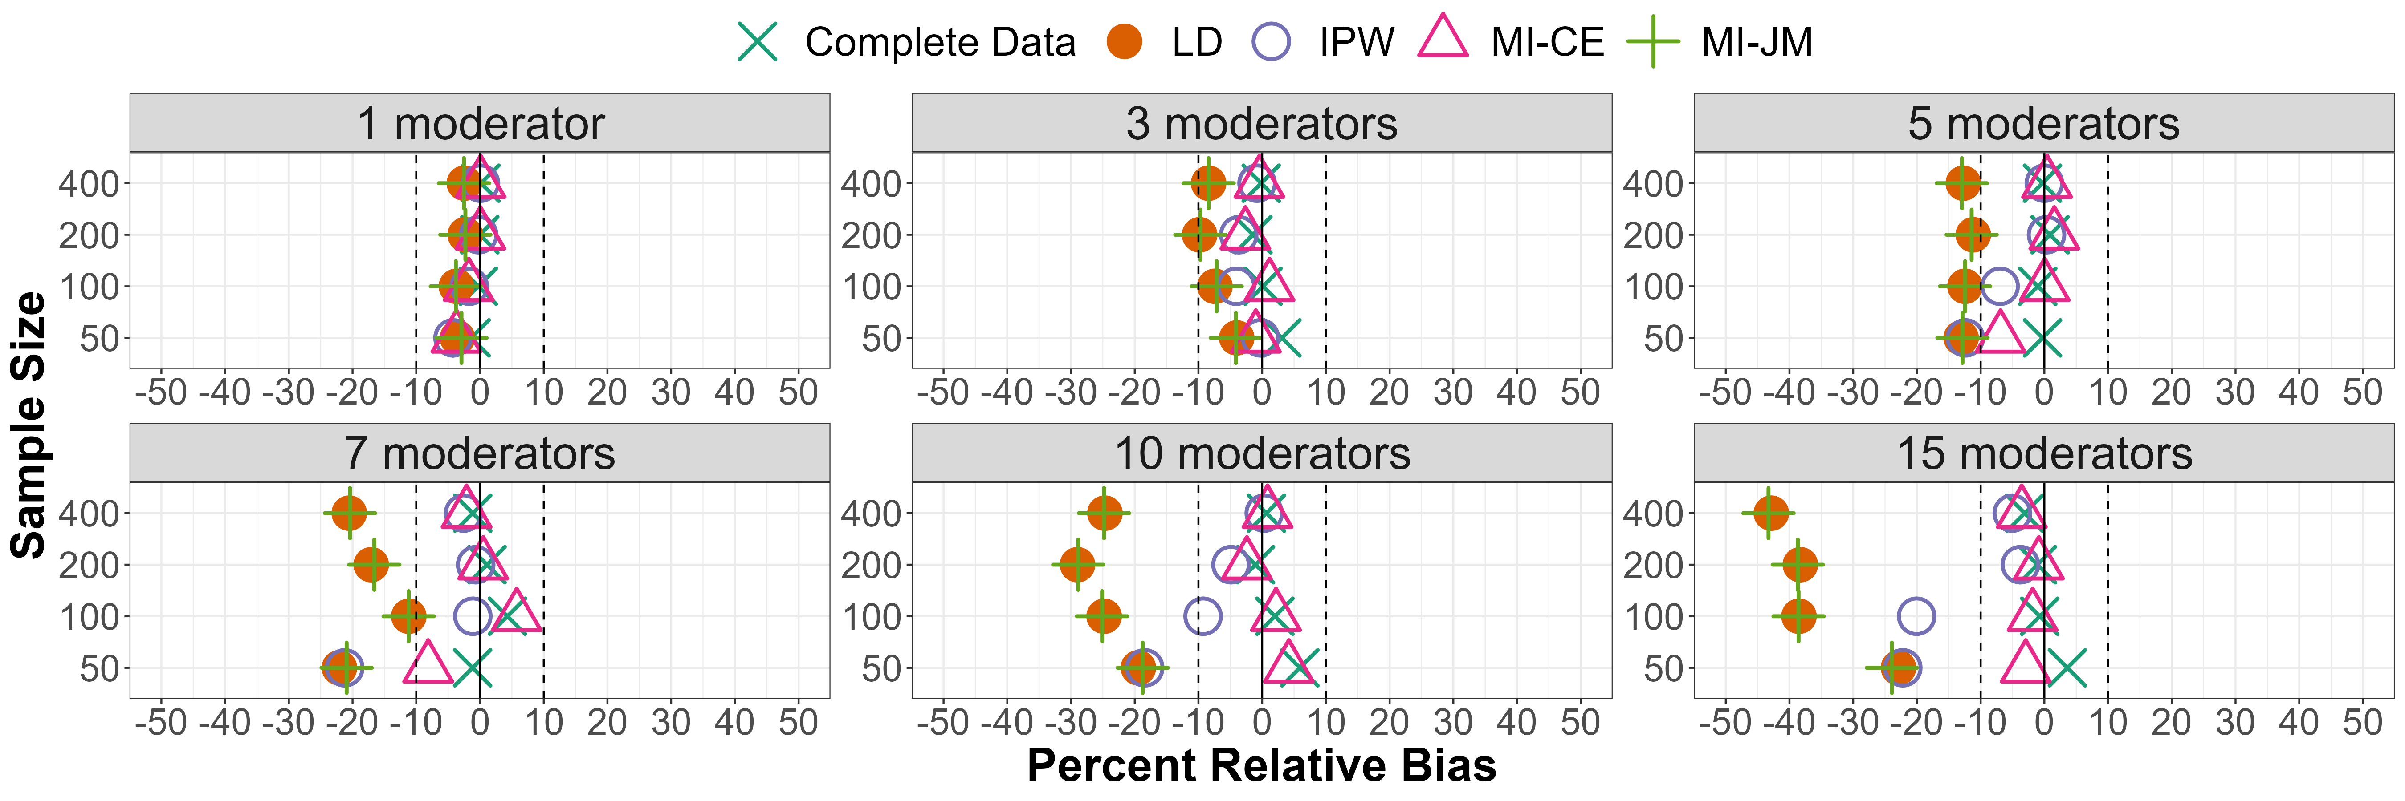
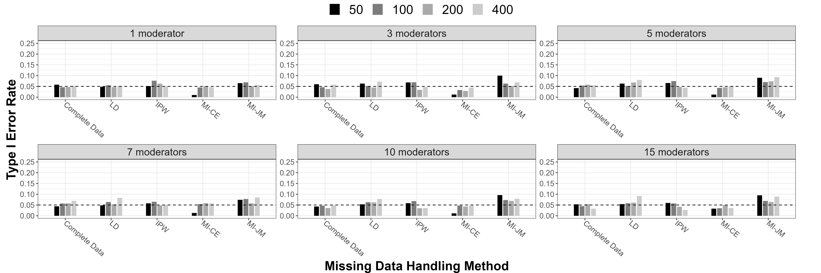
Results Summary

Slide 8
Lessons Learned
  R versioning on local machine & HPC
  Run time limitations in HPC environment
  Exporting csv files

Slide 9
Manuscripts & Contributions
First manuscript in progress, target 5/2024
Submission to Behavioral Health Research Methods
Inclusion of code for methods within Appendices of Manuscript

